Slide 1

DATA STRUCTURES AND ALGORITHMS (113215)
Dr. Owais Hussain

Slide 2

Agenda
Linked List
Linked List Operations
Header Linked List
Circular Linked List
Doubly Linked List
Doubly Header Linked List
Time Complexity

Slide 3

Sample 2
Imagine…

Slide 4
Sample 2
Linked List
You are stuck in traffic on your way to home. When you don’t see traffic moving at all for 10 minutes, you’ll likely notice the car behind you honking. In response, you also sound your horn to the next car, which passes the same gesture to the vehicle next to it. This chain continues until it reaches the frontmost car.
In this case, you only know about the car in front of you, not the rest of the traffic, but you’re still sure that your message of sounding the horn will be passed on to the main culprit who’s blocking the traffic.
Linked lists work in somewhat similar fashion.

Slide 5
Sample 2
Linked List
A Dynamic Linear Data Structure.
Its size can be increased and reduced on demand.
A Linked List is a collection of “Nodes” in which each node consists of two components:
Element/Item: holds the data
Pointer: holds the address of the next node.
In a Linked list, each node “links” to the next node. So, when the program runs, we only know the address of first node. That node contains the address of second node, which contains the address of 3rd node and so on.

Slide 6
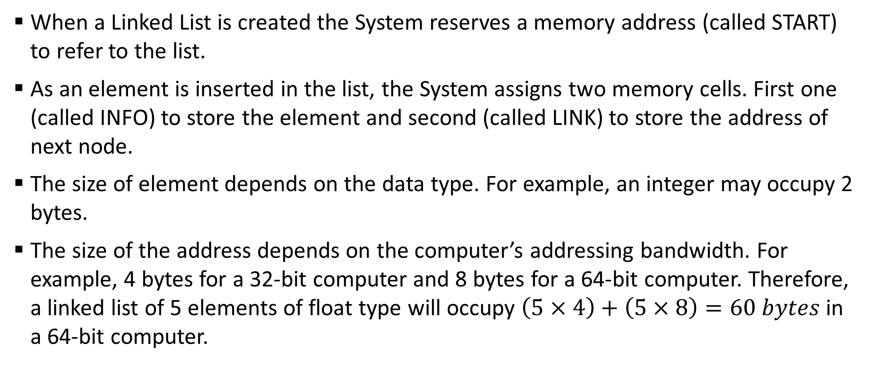
Sample 2
Linked List – Memory representation
When a Linked List is created the System reserves a memory address (called START) to refer to the list.
As an element is inserted in the list, the System assigns two memory cells. First one (called INFO) to store the element and second (called LINK) to store the address of next node.
The size of element depends on the data type. For example, an integer may occupy 2 bytes.
The size of the address depends on the computer’s addressing bandwidth. For example, 4 bytes for a 32-bit computer and 8 bytes for a 64-bit computer. Therefore, a linked list of 5 elements of float type will occupy $\left(5×4\right)+\left(5×8\right)=60 bytes$ in a 64-bit computer.

Slide 7
Sample 2
Linked List – Memory representation
In the given example, INFO represents data {Hafs, Asra, Mohimin} and LINK represents addresses of next node {1080, 1160}.
The START pointer stores the starting address of linked list.
We see a difference of 80 between addresses because every element is a string of 10 characters of 1 bytes each.
START 1000
INFO
Hafs
Asra
Mohimin
LINK
Next: 1080
Next: 1160
Next: Null

Slide 8
Sample 2
Linked List
In this Linked List that contains student names, the first node is at the address 1000 and 10 bytes.
It also contains an address of the next node which is 1080.
Last node does not carry any address next to it.
At first glance, this looks quite similar to an array. But the real magic is when we want to insert or delete something.
Hafs (1000)
Next: 1080
Next: 1160
Mohimin (1160)
Next: (1240)
Asra (1080)
Shahzaman (1240)
Next: (1320)
Omar Baig (1320)
Next: (1400)
Omar Khan (1400)
Next: Null

Slide 9
Sample 2
Linked List Operations – INSERT
Hafs (1000)
Next: 1080
Next: 1160
Mohimin (1160)
Next: (1240)
Asra (1080)
Shahzaman (1240)
Next: (1320)
Omar Baig (1320)
Next: (1400)
Omar Khan (1400)
Next: 3000
Uzair (3000)
Next: Null
Hafs (1000)
Next: 1080
Next: 1160
Mohimin (1160)
Next: (1240)
Asra (1080)
Shahzaman (1240)
Next: (1320)
Omar Baig (1320)
Next: (1400)
Omar Khan (1400)
Next: Null
Let’s add another student “Uzair”. This student should come right after Omar Khan.
We ask the OS to assign memory for a new Node. We were expecting 1480 to be the new address, However, the OS gives us an address 3000 since addressing is dynamic.
Now the new node is attached to address 3000 and Omar Khan’s pointer stores this address.
Hafs (1000)
Next: 1080
Next: 1160
Mohimin (1160)
Next: (1240)
Asra (1080)
Shahzaman (1240)
Next: (1320)
Omar Baig (1320)
Next: (1400)
Omar Khan (1400)
Next: Null
Notes:
Pointer is a special variable, which stores a memory address. It is not used to keep actual data.

Slide 10
Sample 2
Linked List Operations – INSERT
Note the key difference from an Array here. In case of an array, the memory is already allocated on initializing. So, the address of Uzair would be 1480.
In an array, there’s already reserved space in memory for new items. Here, we see that the program requests the OS to allocate more memory when needed.
If there’s no more memory to allocate, then the OS will send an error. This condition is called “Memory Overflow”.
The main advantage is that we can add as many items as we like until the memory is full.
Notes:
We cannot simply jump to next node by adding calculating the memory address because the addresses are now unpredictable.

Slide 11
Hafs
Linked list is initialized with first Node at address 1000
Next: Null
Hafs
Asra
A new Node is added at address 1080 and the pointer of first node is set to 1080
Next: 1080
Next: Null
Hafs
Asra
Mohimin
Another node is added, and the pointer of previous node is set
Next: 1080
Next: 1160
Next: Null
Hafs
Asra
Mohimin
Shahzaman
Next: 1080
Next: 1160
Next: 1240
Next: Null
Hafs
Asra
Mohimin
Shahzaman
Omar Baig
Next: 1080
Next: 1160
Next: 1240
Next: 1320
Next: Null
Hafs
Asra
Mohimin
Shahzaman
Omar Baig
Omar Khan
Next: 1080
Next: 1160
Next: 1240
Next: 1320
Next: 1400
Next: Null

Slide 12
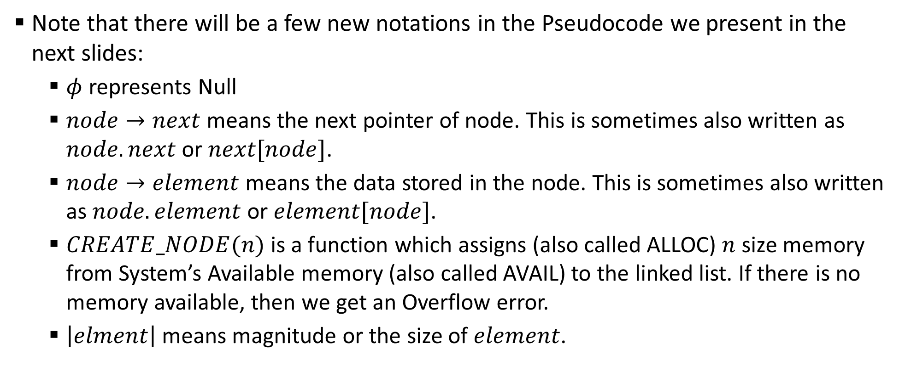
Sample 2
Before we move on…
Note that there will be a few new notations in the Pseudocode we present in the next slides:
$φ$ represents Null
$node→next$ means the next pointer of node. This is sometimes also written as $node.next$ or $next[node]$.
$node→element$ means the data stored in the node. This is sometimes also written as $node.element$ or $element[node]$.
$CREATE_NODE(n)$ is a function which assigns (also called ALLOC) $n$ size memory from System’s Available memory (also called AVAIL) to the linked list. If there is no memory available, then we get an Overflow error.
$\left|elment\right|$ means magnitude or the size of $element$.

Slide 13
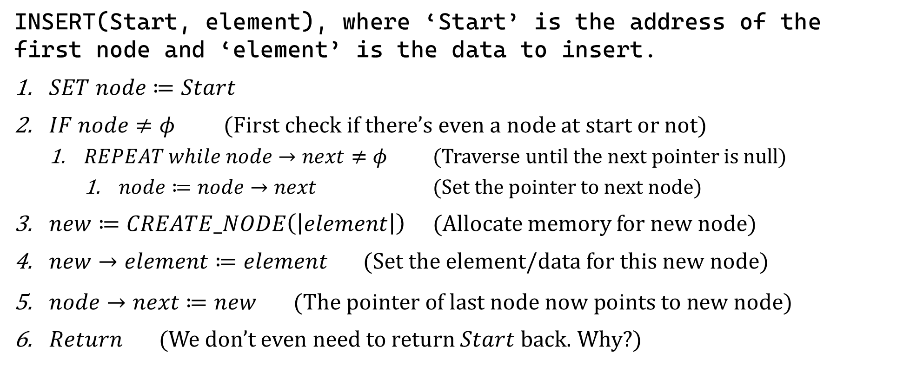
Sample 2
Linked List Operations – INSERT
INSERT(Start, element), where ‘Start’ is the address of the first node and ‘element’ is the data to insert.
$SET node≔Start$
$IF node≠φ$ (First check if there’s even a node at start or not)
$REPEAT while node→next≠φ$ (Traverse until the next pointer is null)
$node≔node→next$ (Set the pointer to next node)
$new≔CREATE_NODE\left(\left|element\right|\right)$ (Allocate memory for new node)
$new→element≔element$ (Set the element/data for this new node)
$node→next≔new$ $\text{ (}\text{The} \text{pointer} \text{of} \text{last} \text{node} \text{now} \text{points} \text{to} \text{new} \text{node}\text{)}$
$Return$ (We don’t even need to return $Start$ back. Why?)
Notes:
Since the pointers hold memory addresses, the same Start variable will contain the pointer to next Node whether we return it or not.

Slide 14
Sample 2
Linked List Operations – TRAVERSE
Since we no longer have a way to calculate address of next node, therefore traversing is Node to Node.
In each iteration, the data from Node is read. The pointer of each node then gives us address to the next node.
Traversing stops when the pointer of current node is null.

Slide 15
Sample 2
Linked List Operations - TRAVERSE
START
1000
Hafs
Next: 1080
Hafs
Asra
Next: 1080
Next: 1160
Hafs
Asra
Mohimin
Next: 1080
Next: 1160
Next: 1240
Hafs
Asra
Mohimin
Shahzaman
Next: 1080
Next: 1160
Next: 1240
Next: 1320
Hafs
Asra
Mohimin
Shahzaman
Omar Baig
Next: 1080
Next: 1160
Next: 1240
Next: 1320
Next: 1400
Hafs
Asra
Mohimin
Shahzaman
Omar Baig
Omar Khan
Next: 1080
Next: 1160
Next: 1240
Next: 1320
Next: 1400
Next: Null
Notes:
At start, we do not even know the size of our Linked List. We only rely on a single hint, i.e., the next pointer is Null or not

Slide 16
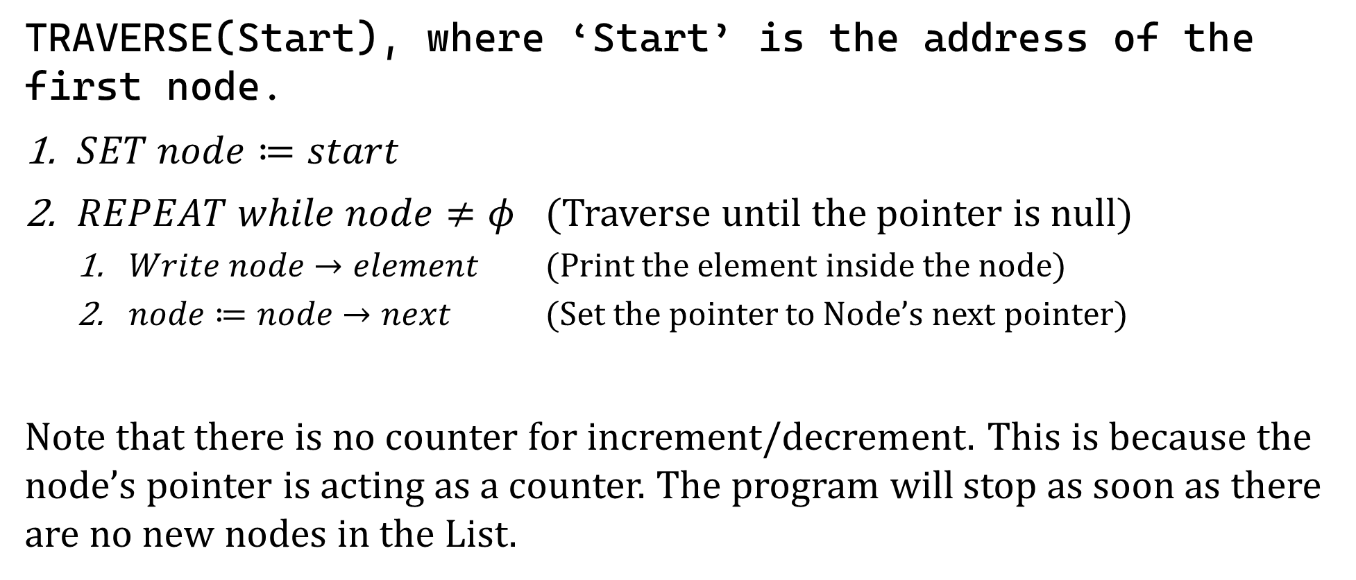
Sample 2
Linked List Operations – TRAVERSE
TRAVERSE(Start), where ‘Start’ is the address of the first node.
$SET node≔start$
$REPEAT while node≠φ$ (Traverse until the pointer is null)
$Write node→element$ (Print the element inside the node)
$node≔node→next$ (Set the pointer to Node’s next pointer)
Note that there is no counter for increment/decrement. This is because the node’s pointer is acting as a counter. The program will stop as soon as there are no new nodes in the List.

Slide 17
Sample 2
Linked List Operations – SEARCH
Search operation will be similar to Traverse, but it will input another parameter “element” to search for.
We traverse the Linked List and match the data with the parameter “element”.
Recall that in case of arrays, we returned the index at which the element was found.
In case of Linked List, we return the Node.

Slide 18
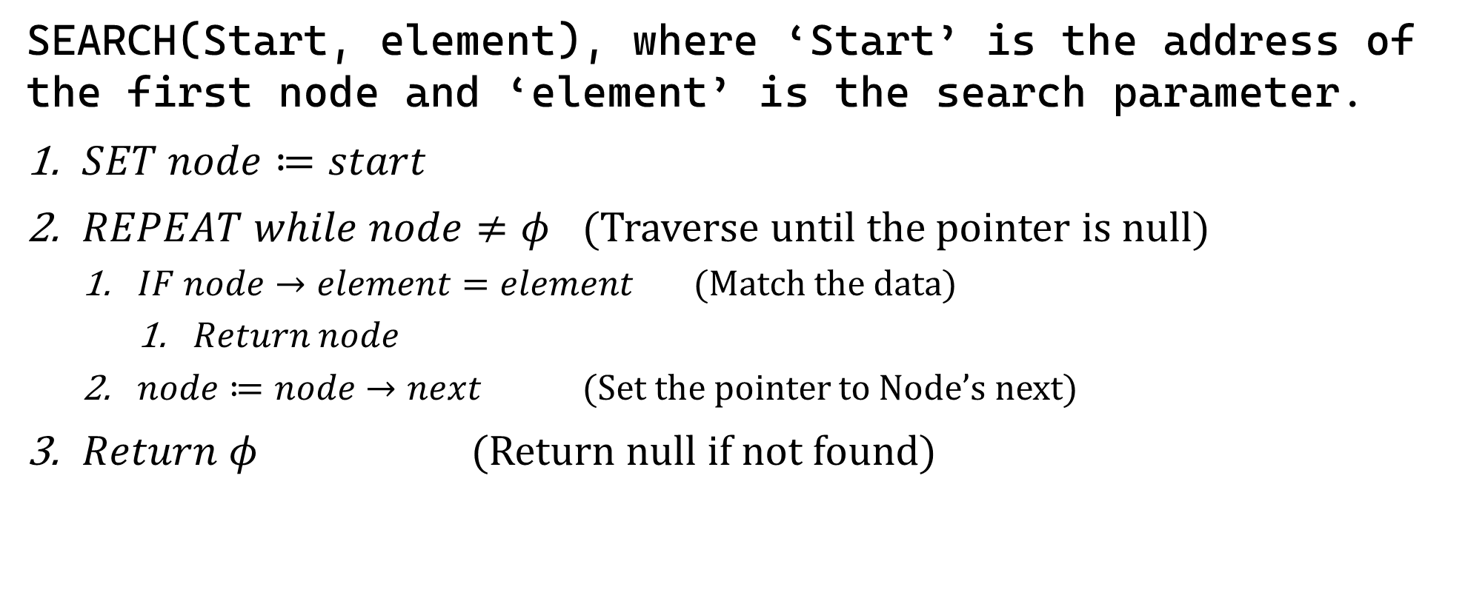
Sample 2
Linked List Operations – SEARCH
SEARCH(Start, element), where ‘Start’ is the address of the first node and ‘element’ is the search parameter.
$SET node≔start$
$REPEAT while node≠φ$ (Traverse until the pointer is null)
$IF node→element=element$ (Match the data)
$Return node$
$node≔node→next$ (Set the pointer to Node’s next)
$Return φ$ (Return null if not found)

Slide 19
Sample 2
Linked List Operations – DELETE
Hafs (1000)
Next: 1080
Next: 1240
Asra (1080)
Shahzaman (1240)
Next: (1320)
Omar Baig (1320)
Next: (1400)
Omar Khan (1400)
Next: 3000
Uzair (3000)
Next: Null
REMOVE IT
Let’s now delete a student “Mohimin” from this linked list.
When we perform a delete operation on Arrays, we push each item from right to left and thus overwrite the data on target index.
In Linked Lists, we will simply set the Next pointer of Asra (1160) to link to Shahzaman (1240). This way, the address of Mohimin will be lost.
Additionally, we will send a signal to OS to free up the memory taken by Mohimin at address 1160.
This memory clearing step is not required in modern languages as they run a “Garbage collection” service to clean up memory.
Hafs (1000)
Next: 1080
Next: 1160
Next: (1240)
Asra (1080)
Shahzaman (1240)
Next: (1320)
Omar Baig (1320)
Next: (1400)
Omar Khan (1400)
Next: 3000
Uzair (3000)
Next: Null
Mohimin (1160)

Slide 20
Sample 2
Linked List Operations – DELETE
START
1000
Hafs
Asra
Mohimin
Shahzaman
Omar Baig
Omar Khan
Next: 1080
Next: 1160
Next: 1240
Next: 1320
Next: 1400
Next: Null
Find the Node to delete
START
1000
Hafs
Asra
Mohimin
Shahzaman
Omar Baig
Omar Khan
Next: 1080
Next: 1160
Next: 1240
Next: 1320
Next: 1400
Next: Null
Link to the node after target node
START
1000
Hafs
Asra
Shahzaman
Omar Baig
Omar Khan
Next: 1080
Next: 1240
Next: 1320
Next: 1400
Next: Null
Target node is now detached
Mohimin
Free up this memory space
Or garbage collection service will free it in some time
Next: 1240

Slide 21
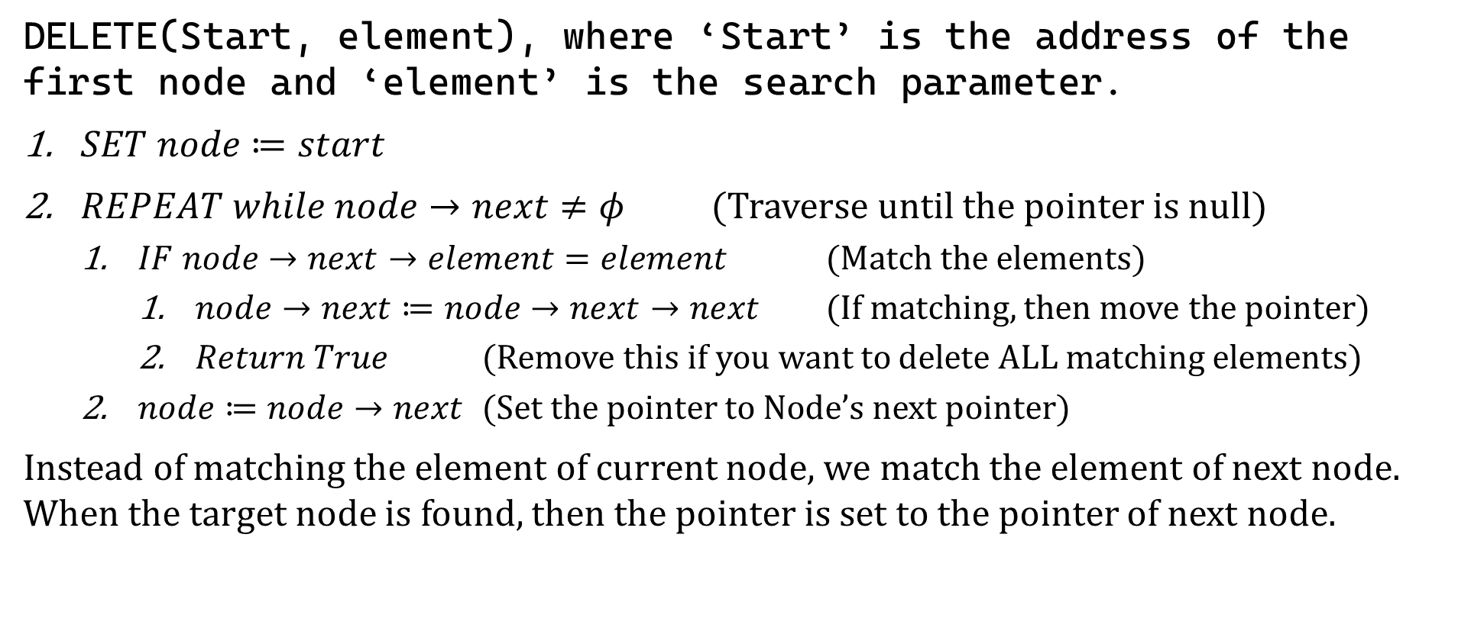
Sample 2
Linked List Operations – DELETE
DELETE(Start, element), where ‘Start’ is the address of the first node and ‘element’ is the search parameter.
$SET node≔start$
$REPEAT while node→next≠φ$ (Traverse until the pointer is null)
$IF node→next→element=element$ (Match the elements)
$node→next≔node→next→next$ (If matching, then move the pointer)
$Return True$ (Remove this if you want to delete ALL matching elements)
$node≔node→next$ (Set the pointer to Node’s next pointer)
Instead of matching the element of current node, we match the element of next node. When the target node is found, then the pointer is set to the pointer of next node.

Slide 22
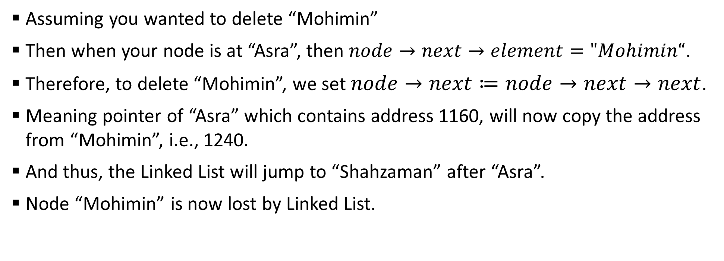
Sample 2
Linked List Operations – DELETE
START
1000
Hafs
Asra
Mohimin
Shahzaman
Omar Baig
Omar Khan
Next: 1080
Next: 1160
Next: 1240
Next: 1320
Next: 1400
Next: Null
Assuming you wanted to delete “Mohimin”
Then when your node is at “Asra”, then $node→next→element="Mohimin“$.
Therefore, to delete “Mohimin”, we set $node→next≔node→next→next$.
Meaning pointer of “Asra” which contains address 1160, will now copy the address from “Mohimin”, i.e., 1240.
And thus, the Linked List will jump to “Shahzaman” after “Asra”.
Node “Mohimin” is now lost by Linked List.

Slide 23
Sample 2
Linked List Operations – DELETE
A common error related to DELETE operation is Underflow.
Underflow is a condition in which we are trying to delete a node which does not exist. This can be caused due to bad memory management.
For example, after successfully Deleting node “Mohimin”, if any of the pointers is still holding its address 1160, then if we try to call Delete operation again, the program will fail because of Underflow, not because the item was not found.

Slide 24
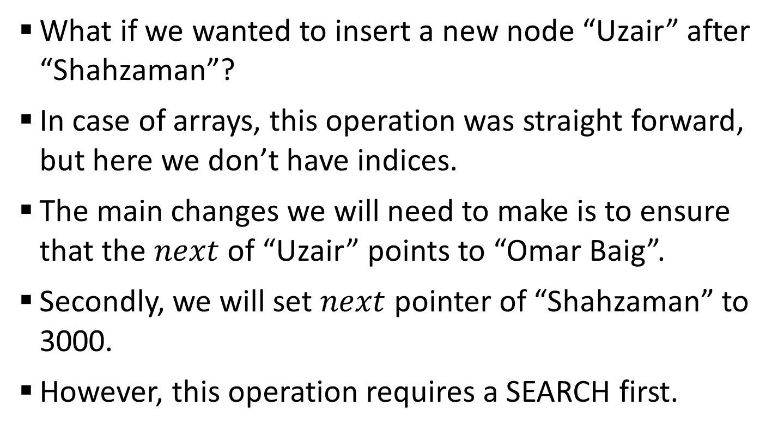
Sample 2
Linked List Operations – INSERT AFTER
What if we wanted to insert a new node “Uzair” after “Shahzaman”?
In case of arrays, this operation was straight forward, but here we don’t have indices.
The main changes we will need to make is to ensure that the $next$ of “Uzair” points to “Omar Baig”.
Secondly, we will set $next$ pointer of “Shahzaman” to 3000.
However, this operation requires a SEARCH first.
Hafs (1000)
Next: 1080
Next: 1160
Mohimin (1160)
Next: (1240)
Asra (1080)
Shahzaman (1240)
Next: (3000)
Omar Baig (1320)
Next: (1400)
Omar Khan (1400)
Next: null
Uzair (3000)
Next: 1320

Slide 25
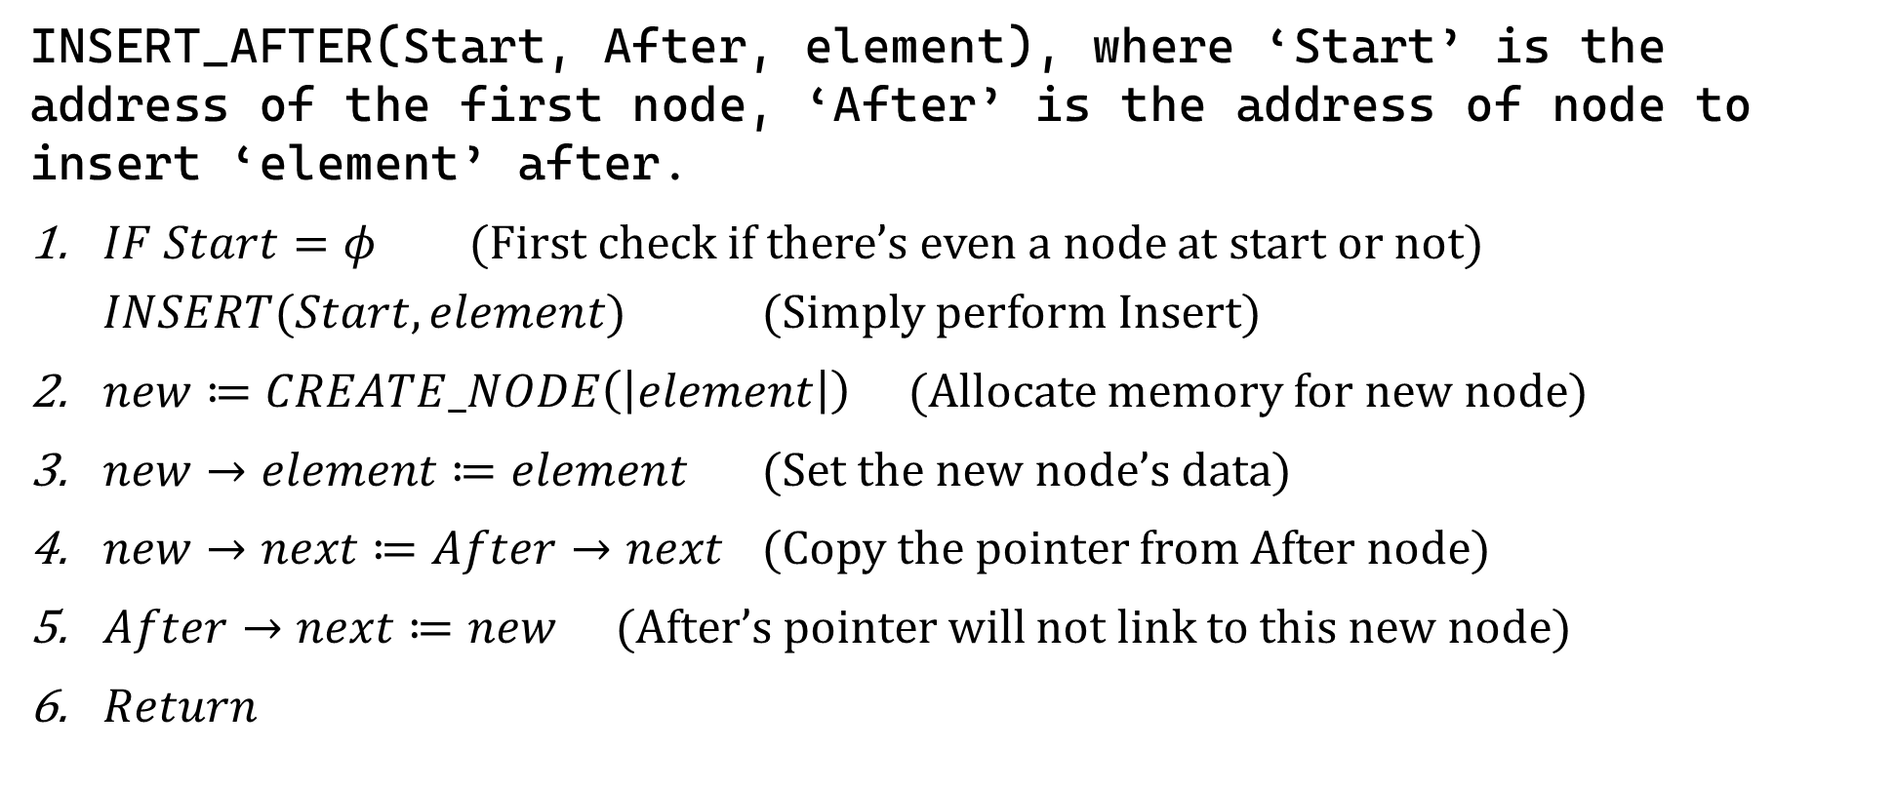
Sample 2
Linked List Operations – INSERT AFTER
INSERT_AFTER(Start, After, element), where ‘Start’ is the address of the first node, ‘After’ is the address of node to insert ‘element’ after.
$IF Start=φ$ (First check if there’s even a node at start or not)
$INSERT(Start, element)$ (Simply perform Insert)
$new≔CREATE_NODE\left(\left|element\right|\right)$ (Allocate memory for new node)
$new→element≔element$ (Set the new node’s data)
$new→next≔After→next$ (Copy the pointer from After node)
$After→next≔new$ (After’s pointer will not link to this new node)
$Return$

Slide 26
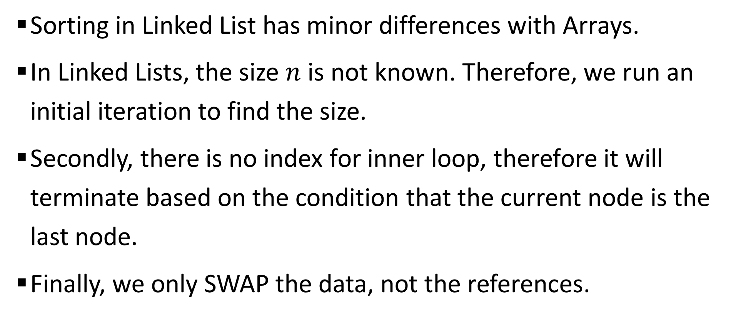
Sample 2
Linked List Operations – BUBBLE SORT
Sorting in Linked List has minor differences with Arrays.
In Linked Lists, the size $n$ is not known. Therefore, we run an initial iteration to find the size.
Secondly, there is no index for inner loop, therefore it will terminate based on the condition that the current node is the last node.
Finally, we only SWAP the data, not the references.

Slide 27
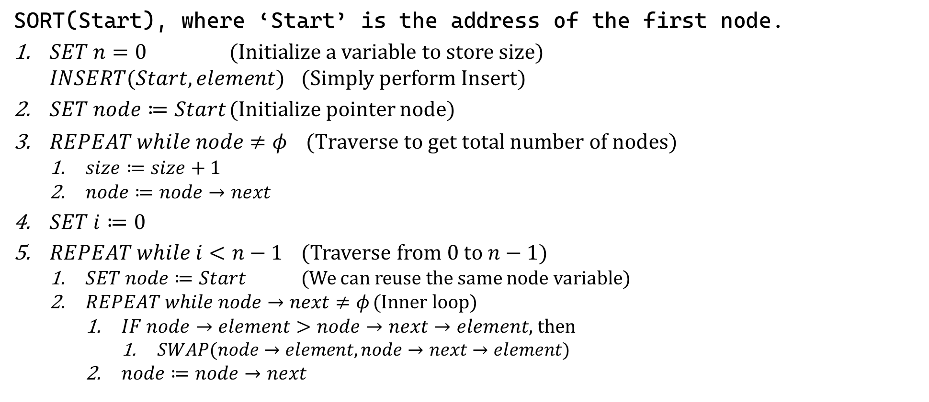
Sample 2
Linked List Operations – SORT
SORT(Start), where ‘Start’ is the address of the first node.
$SET n=0$ (Initialize a variable to store size)
$INSERT(Start, element)$ (Simply perform Insert)
$SET node≔Start$ (Initialize pointer node)
$REPEAT while node≠φ$ $\text{(}\text{Traverse} \text{to} \text{get} \text{total} \text{number} \text{of} \text{nodes}\text{)}$
$size≔size+1$
$node≔node→next$
$SET i≔0$
$REPEAT while i<n−1$ (Traverse from 0 to $n−1$)
$SET node≔Start$ (We can reuse the same node variable)
$REPEAT while node→next≠φ$ (Inner loop)
$IF node→element>node→next→element$, then
$SWAP(node→element, node→next→element)$
$node≔node→next$

Slide 28
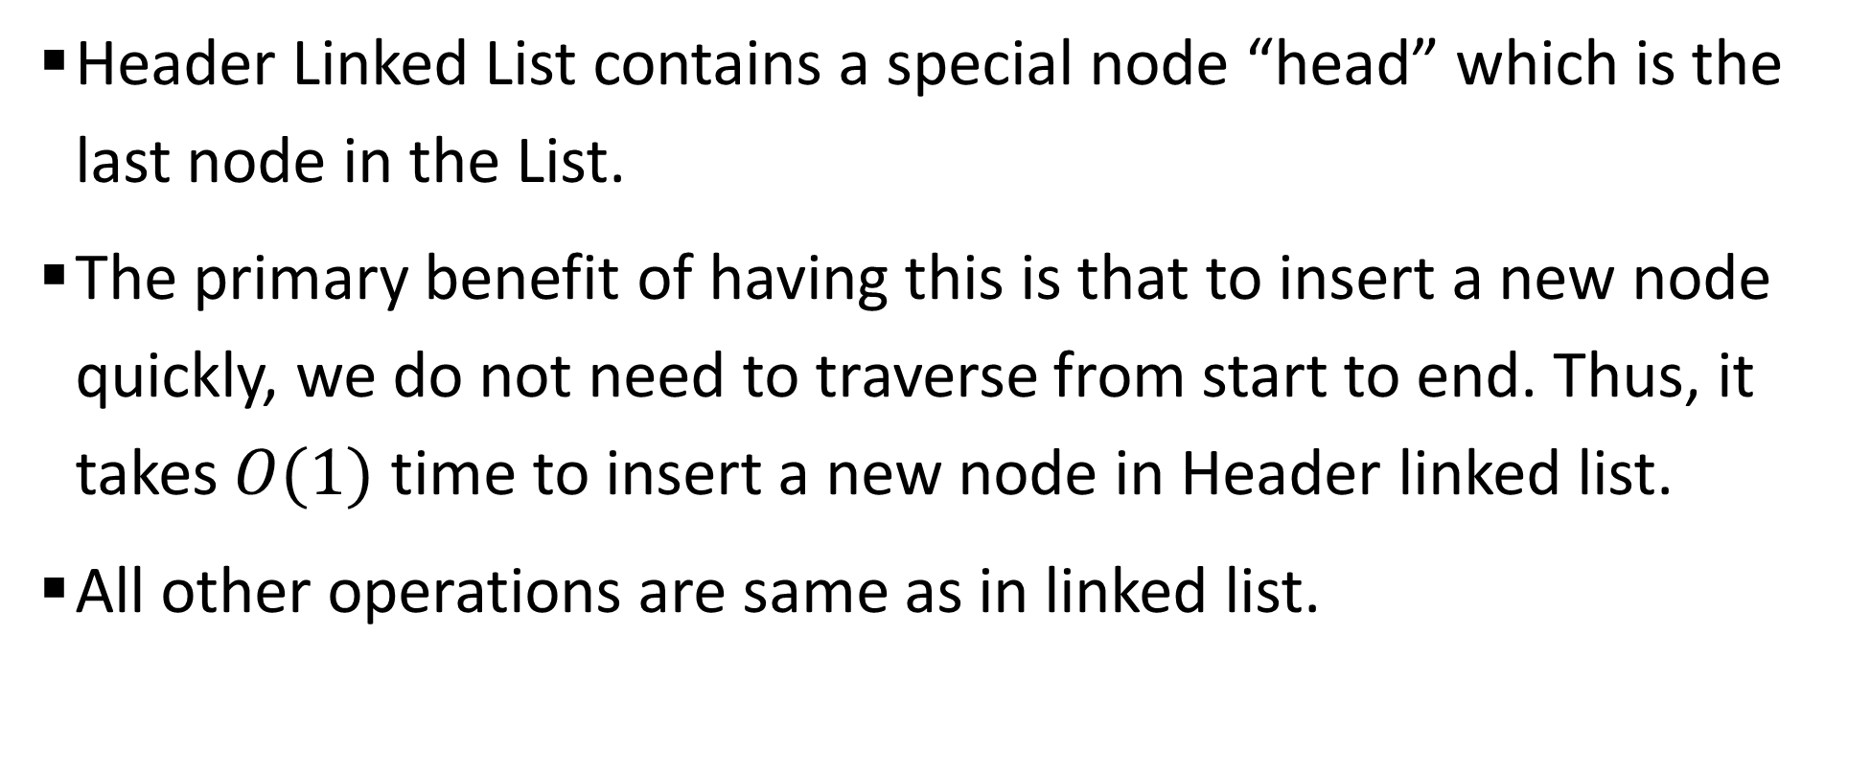
Sample 2
Header Linked List
Header Linked List contains a special node “head” which is the last node in the List.
The primary benefit of having this is that to insert a new node quickly, we do not need to traverse from start to end. Thus, it takes $O(1)$ time to insert a new node in Header linked list.
All other operations are same as in linked list.

Slide 29
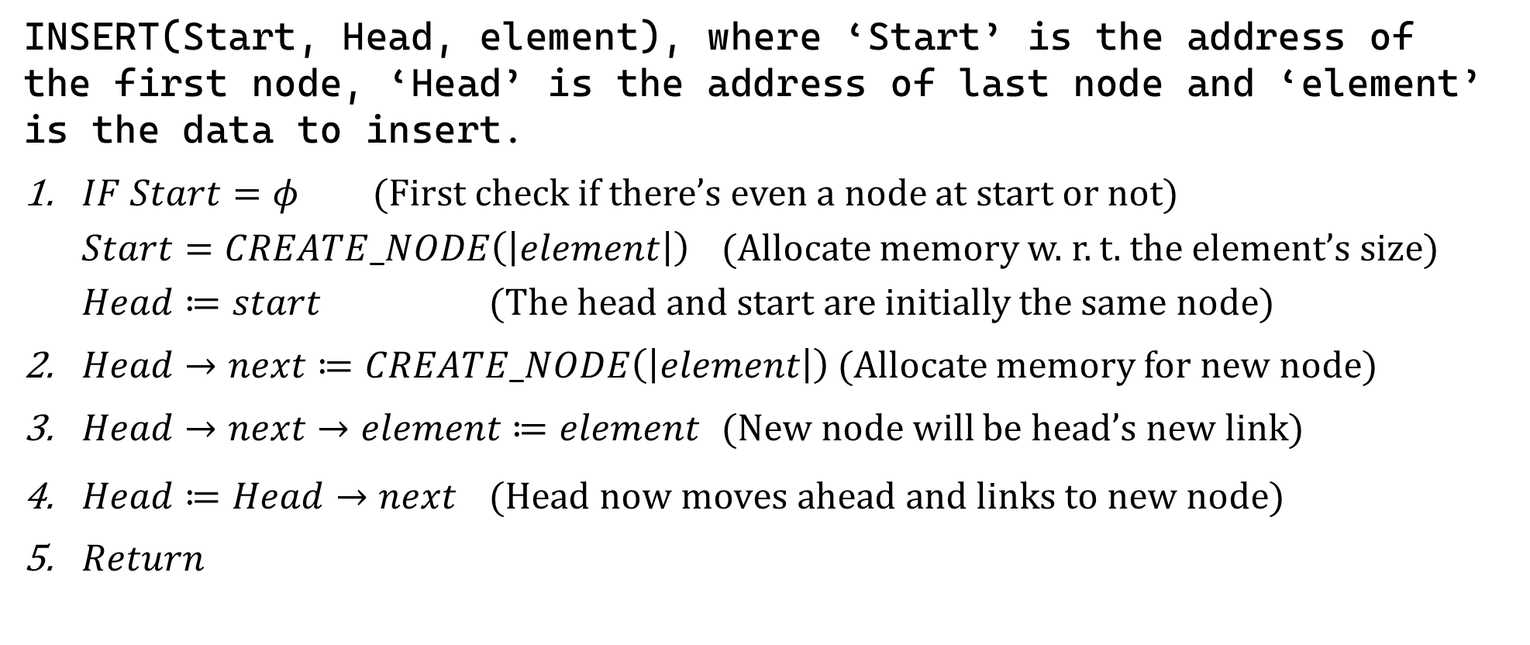
Sample 2
Header Linked List – INSERT
INSERT(Start, Head, element), where ‘Start’ is the address of the first node, ‘Head’ is the address of last node and ‘element’ is the data to insert.
$IF Start=φ$ (First check if there’s even a node at start or not)
$Start=CREATE_NODE\left(\left|element\right|\right)$ (Allocate memory w. r. t. the element’s size)
$Head≔start$ (The head and start are initially the same node)
$Head→next≔CREATE_NODE\left(\left|element\right|\right)$ (Allocate memory for new node)
$Head→next→element≔element$ (New node will be head’s new link)
$Head≔Head→next$ $\text{(}\text{Head} \text{now} \text{moves} \text{ahead} \text{and} \text{links} \text{to} \text{new} \text{node}\text{)}$
$Return$

Slide 30
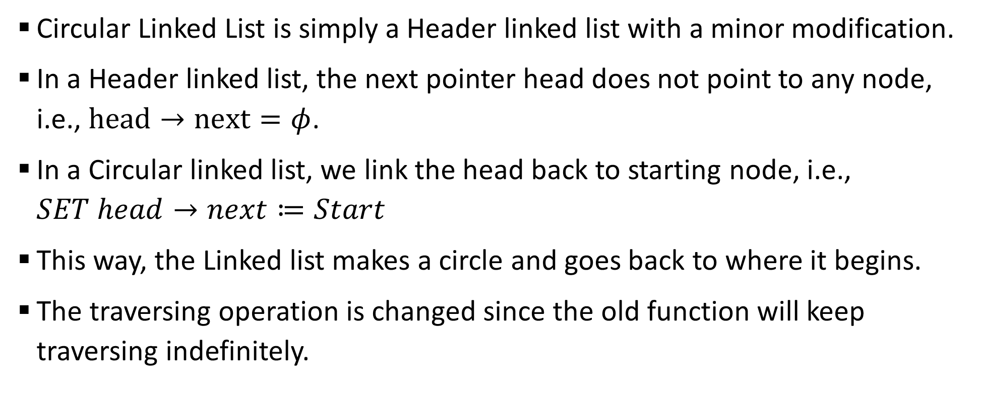
Sample 2
Circular Linked List
Circular Linked List is simply a Header linked list with a minor modification.
In a Header linked list, the next pointer head does not point to any node, i.e., $head→next=φ$.
In a Circular linked list, we link the head back to starting node, i.e., $SET head→next≔Start$
This way, the Linked list makes a circle and goes back to where it begins.
The traversing operation is changed since the old function will keep traversing indefinitely.

Slide 31
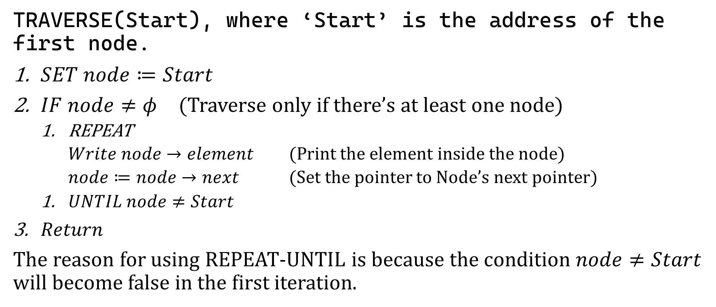
Sample 2
Circular Linked List – TRAVERSE
TRAVERSE(Start), where ‘Start’ is the address of the first node.
$SET node≔Start$
$IF node≠φ$ (Traverse only if there’s at least one node)
REPEAT
$Write node→element$ (Print the element inside the node)
$node≔node→next$ (Set the pointer to Node’s next pointer)
$UNTIL node≠Start$
$Return$
The reason for using REPEAT-UNTIL is because the condition $node≠Start$ will become false in the first iteration.

Slide 32
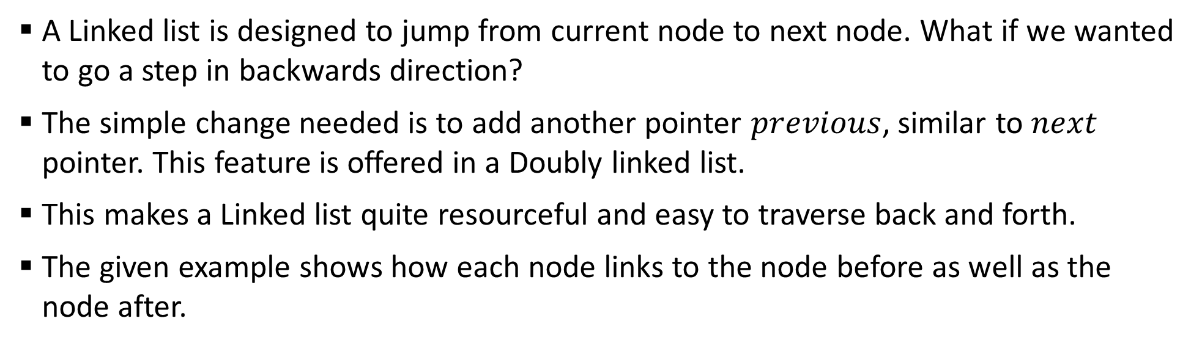
Sample 2
Doubly Linked List
A Linked list is designed to jump from current node to next node. What if we wanted to go a step in backwards direction?
The simple change needed is to add another pointer $previous$, similar to $next$ pointer. This feature is offered in a Doubly linked list.
This makes a Linked list quite resourceful and easy to traverse back and forth.
The given example shows how each node links to the node before as well as the node after.
START
1000
Hafs
Asra
Mohimin
Shahzaman
Next: 1080
Next: 1160
Next: 1240
Next: Null
Previous: Null
Previous: 1000
Previous: 1160
Previous: 1240

Slide 33
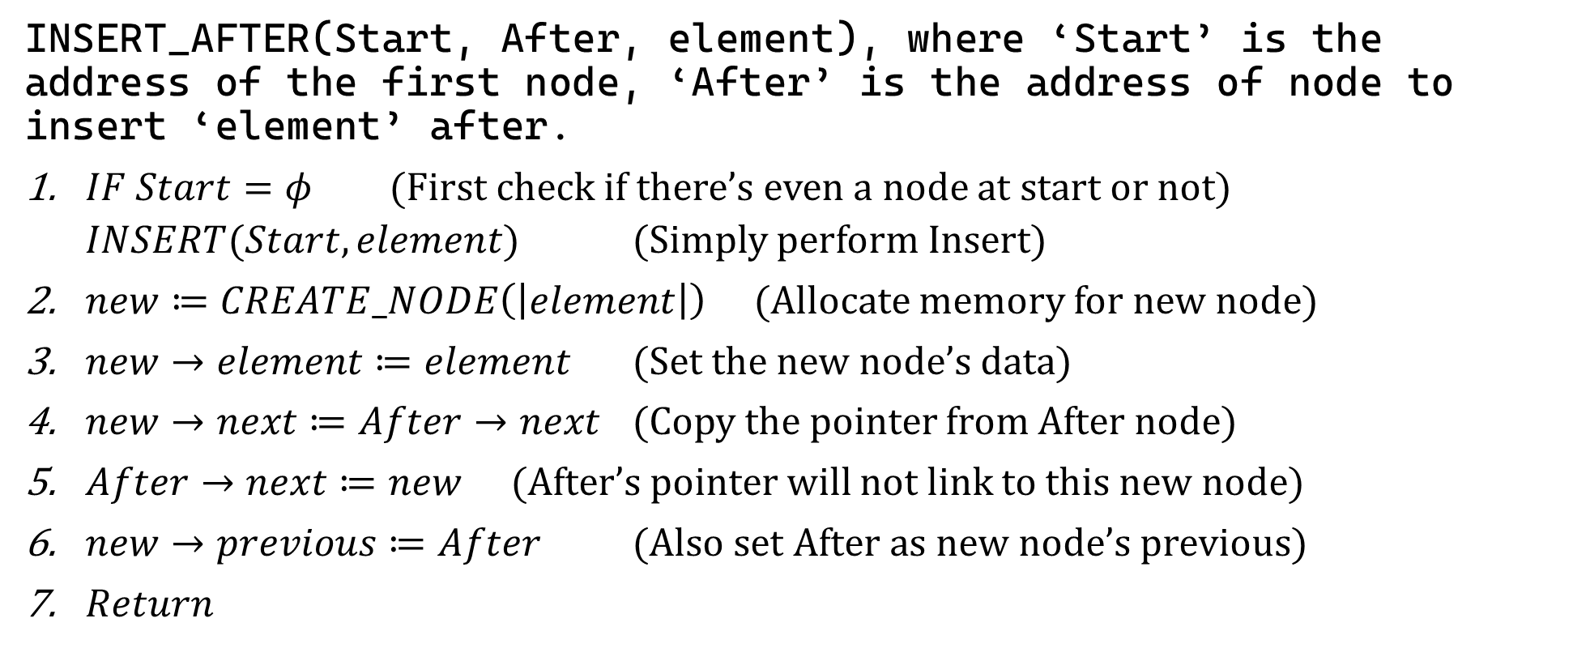
Sample 2
Doubly Linked List – INSERT AFTER
INSERT_AFTER(Start, After, element), where ‘Start’ is the address of the first node, ‘After’ is the address of node to insert ‘element’ after.
$IF Start=φ$ (First check if there’s even a node at start or not)
$INSERT(Start, element)$ (Simply perform Insert)
$new≔CREATE_NODE\left(\left|element\right|\right)$ (Allocate memory for new node)
$new→element≔element$ (Set the new node’s data)
$new→next≔After→next$ (Copy the pointer from After node)
$After→next≔new$ (After’s pointer will not link to this new node)
$new→previous≔After$ (Also set After as new node’s previous)
$Return$

Slide 34
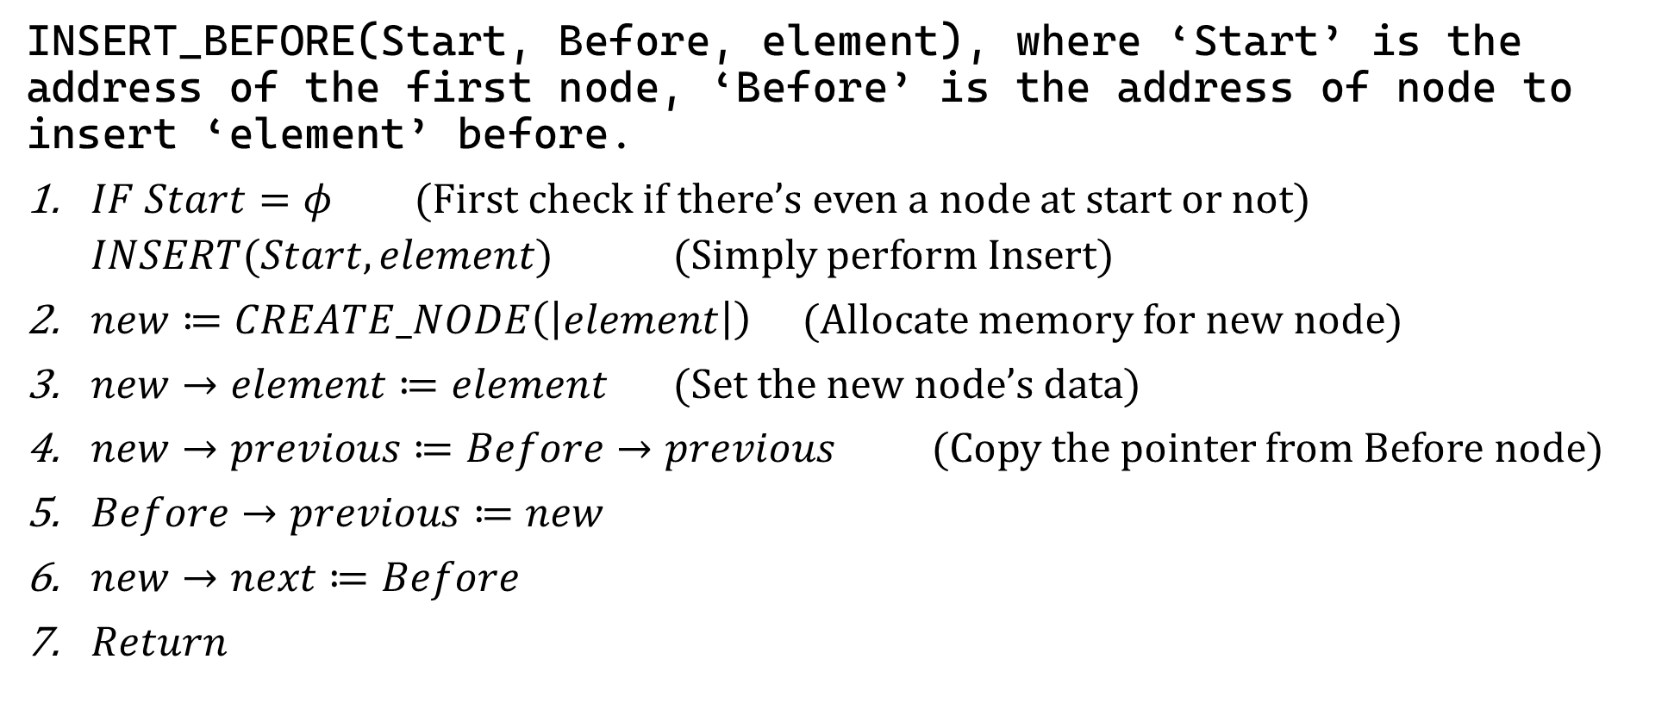
Sample 2
Doubly Linked List – INSERT BEFORE
INSERT_BEFORE(Start, Before, element), where ‘Start’ is the address of the first node, ‘Before’ is the address of node to insert ‘element’ before.
$IF Start=φ$ (First check if there’s even a node at start or not)
$INSERT(Start, element)$ (Simply perform Insert)
$new≔CREATE_NODE\left(\left|element\right|\right)$ (Allocate memory for new node)
$new→element≔element$ (Set the new node’s data)
$new→previous≔Before→previous$ (Copy the pointer from Before node)
$Before→previous≔new$
$new→next≔Before$
$Return$

Slide 35
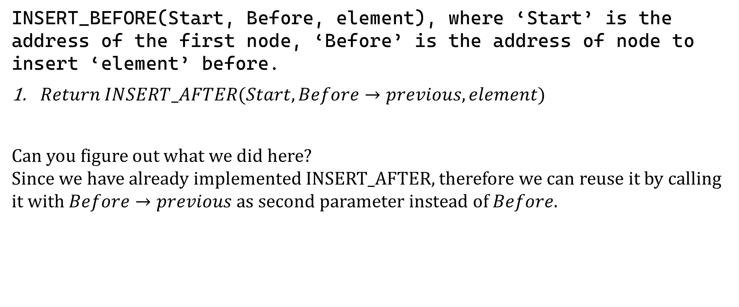
Sample 2
Doubly Linked List – INSERT BEFORE
INSERT_BEFORE(Start, Before, element), where ‘Start’ is the address of the first node, ‘Before’ is the address of node to insert ‘element’ before.
$Return INSERT_AFTER(Start, Before→previous, element)$
Can you figure out what we did here? Since we have already implemented INSERT_AFTER, therefore we can reuse it by calling it with $Before→previous$ as second parameter instead of $Before$.

Slide 36

Sample 2
Doubly Header Linked List
This is NOT a conventional type of linked lists, i.e. it is not an ADT. We are implementing a new type by combining two features of previously discussed linked lists i.e., The $head$ node and $previous$ pointer.
It provides all the features of previous linked lists and also enables us to travel from start to end, as well as in reverse direction.
START
1000
Hafs
Asra
Mohimin
Shahzaman
HEAD
2240
Next: 1080
Next: 1160
Next: 2240
Next: Null
Previous: Null
Previous: 1000
Previous: 1080
Previous: 1160

Slide 37
Sample 2
Exercise
Write Pseudocode and code DoublyHeaderLinkedList by adding:
Traverse
Reverse: traverse in reverse direction
Insert, Insert After and Before
Delete, Delete First and Last
Search
Sort by SID, Name and CGPA
Count: get the number of nodes

Slide 38
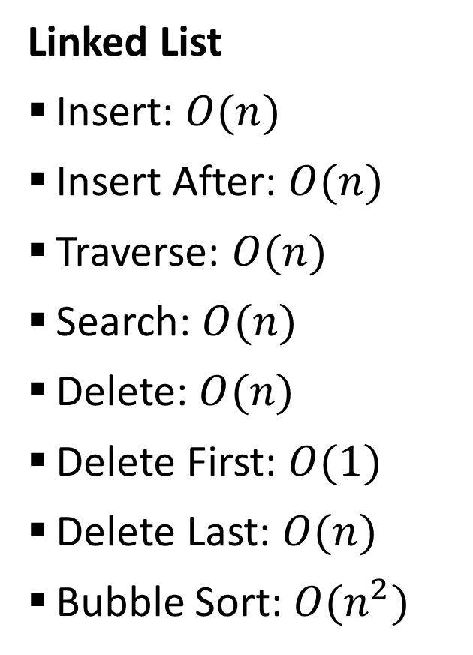
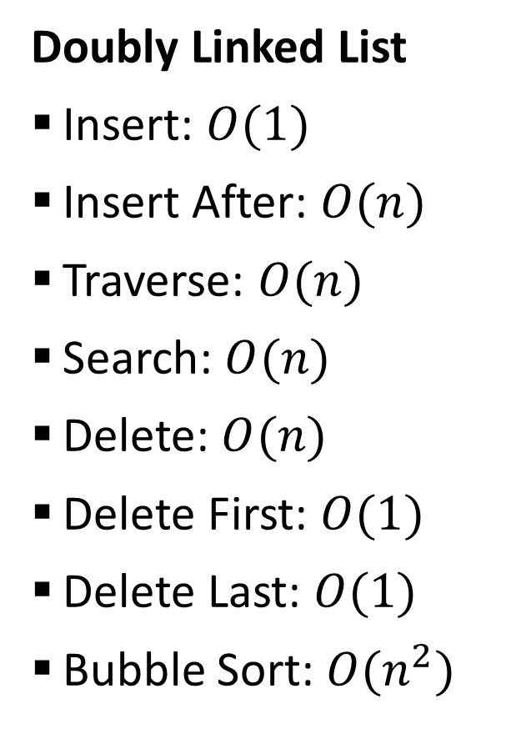
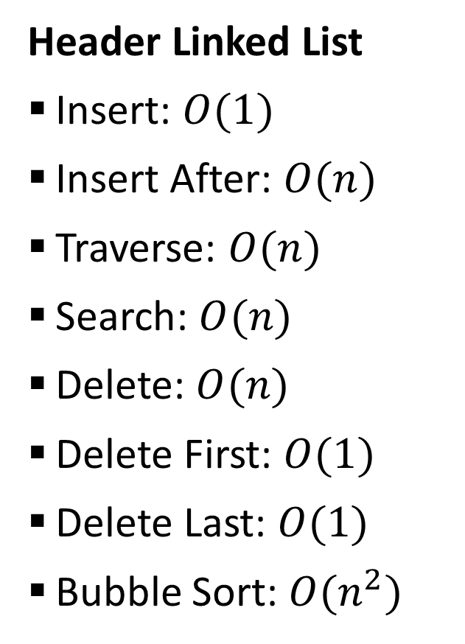
Sample 2
Time Complexity
Linked List
Insert: $O(n)$
Insert After: $O(n)$
Traverse: $O(n)$
Search: $O(n)$
Delete: $O(n)$
Delete First: $O(1)$
Delete Last: $O(n)$
Bubble Sort: $O(n^{2})$
Header Linked List
Insert: $O(1)$
Insert After: $O(n)$
Traverse: $O(n)$
Search: $O(n)$
Delete: $O(n)$
Delete First: $O(1)$
Delete Last: $O(1)$
Bubble Sort: $O(n^{2})$
Doubly Linked List
Insert: $O(1)$
Insert After: $O(n)$
Traverse: $O(n)$
Search: $O(n)$
Delete: $O(n)$
Delete First: $O(1)$
Delete Last: $O(1)$
Bubble Sort: $O(n^{2})$

Slide 39
Sample 2
DIY
Practice the following from the textbook:
Q 5.14
Q 5.18
Q 5.22
Q 5.25
Write a circular linked list program to demonstrate working of a clock. The list should contain hours from 0-23 and show how the clock runs. There should be no IF clause in your code.

Slide 40



THANK YOU
Owais Hussain
+92 345-3174270
owais.hussain@kiet.edu.pk
https://www.researchgate.net/profile/Owais-Hussain-3

